Slide 1
mongo DB
Dr. Salahuddin Shaikh

Slide 2
Mongo DB
MongoDB is an open source NoSQL database management program. NoSQL (Not only SQL) is used as an alternative to traditional relational databases. NoSQL databases are quite useful for working with large sets of distributed data. MongoDB is a tool that can manage document-oriented information, store or retrieve information.
MongoDB is used for high-volume data storage, helping organizations store large amounts of data while still performing rapidly. Organizations also use MongoDB for its ad-hoc queries, indexing, load balancing, aggregation, server-side JavaScript execution and other features.

Slide 3
Mongo DB
Structured Query Language (SQL) is a standardized programming language that is used to manage relational databases. SQL normalizes data as schemas and tables, and every table has a fixed structure.
Instead of using tables and rows as in relational databases, as a NoSQL database, the MongoDB architecture is made up of collections and documents. Documents are made up of key-value pairs -- MongoDB's basic unit of data. Collections, the equivalent of SQL tables, contain document sets. MongoDB offers support for many programming languages, such as C, C++, C#, Go, Java, Python, Ruby and Swift.

Slide 4
How does MongoDB work?
MongoDB environments provide users with a server to create databases with MongoDB. MongoDB stores data as records that are made up of collections and documents.
Documents contain the data the user wants to store in the MongoDB database. Documents are composed of field and value pairs. They are the basic unit of data in MongoDB. The documents are similar to JavaScript Object Notation (JSON) but use a variant called Binary JSON (BSON). The benefit of using BSON is that it accommodates more data types.

Slide 5
How does MongoDB work?
The fields in these documents are like the columns in a relational database. Values contained can be a variety of data types, including other documents, arrays and arrays of documents, according to the MongoDB user manual. Documents will also incorporate a primary key as a unique identifier. A document's structure is changed by adding or deleting new or existing fields.
Sets of documents are called collections, which function as the equivalent of relational database tables. Collections can contain any type of data, but the restriction is the data in a collection cannot be spread across different databases. Users of MongoDB can create multiple databases with multiple collections.

Slide 6
Why is MongoDB used?
An organization might want to use MongoDB for the following:
Storage. MongoDB can store large structured and unstructured data volumes and is scalable vertically and horizontally. Indexes are used to improve search performance. Searches are also done by field, range and expression queries.
Data integration. This integrates data for applications, including for hybrid and multi-cloud applications.
Complex data structures descriptions. Document databases enable the embedding of documents to describe nested structures (a structure within a structure) and can tolerate variations in data.
Load balancing. MongoDB can be used to run over multiple servers.

Slide 7
Features of MongoDB
Features of MongoDB include the following:
Replication. A replica set is two or more MongoDB instances used to provide high availability. Replica sets are made of primary and secondary servers. The primary MongoDB server performs all the read and write operations, while the secondary replica keeps a copy of the data. If a primary replica fails, the secondary replica is then used.
Scalability. MongoDB supports vertical and horizontal scaling. Vertical scaling works by adding more power to an existing machine, while horizontal scaling works by adding more machines to a user's resources.

Slide 8
Features of MongoDB
Features of MongoDB include the following:
Load balancing. MongoDB handles load balancing without the need for a separate, dedicated load balancer, through either vertical or horizontal scaling.
Schema-less. MongoDB is a schema-less database, which means the database can manage data without the need for a blueprint.
Document. Data in MongoDB is stored in documents with key-value pairs instead of rows and columns, which makes the data more flexible when compared to SQL databases.

Slide 9
Installing MongoDB:
Just go to http://www.mongodb.org/downloads and select your operating system out of Windows, Linux, Mac OS X and Solaris. A detailed explanation about the installation of MongoDB is given on their site.
For Windows, a few options for the 64-bit operating systems drops down. When you’re running on Windows 7, 8 or newer versions, select Windows 64-bit 2008 R2+. When you’re using Windows XP or Vista then select Windows 64-bit 2008 R2+ legacy.

Slide 10
Database
Database is a physical container for collections. Each database gets its own set of files on the file system. A single MongoDB server typically has multiple databases.
Collection
Collection is a group of MongoDB documents. It is the equivalent of an RDBMS table. A collection exists within a single database. Collections do not enforce a schema. Documents within a collection can have different fields. Typically, all documents in a collection are of similar or related purpose.
Document
A document is a set of key-value pairs. Documents have dynamic schema. Dynamic schema means that documents in the same collection do not need to have the same set of fields or structure, and common fields in a collection's documents may hold different types of data.

Slide 11
how to create a database in MongoDB
MongoDB use DATABASE_NAME is used to create database. The command will create a new database if it doesn't exist, otherwise it will return the existing database.
Syntax
Basic syntax of use DATABASE statement is as follows −
use DATABASE_NAME

Slide 12
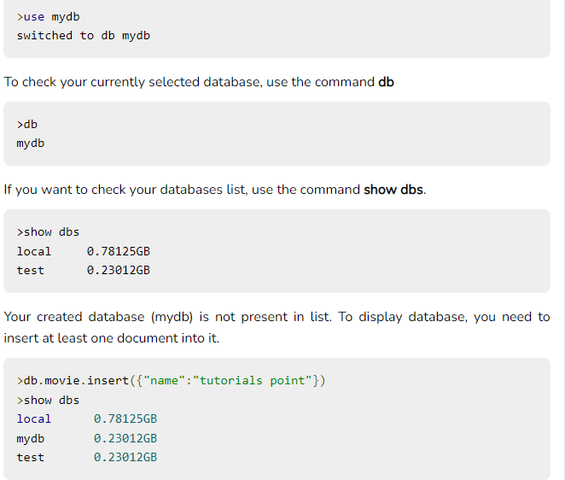
Example
If you want to use a database with name <mydb>, then use DATABASE statement would be as follows −
In MongoDB default database is test. If you didn't create any database, then collections will be stored in test database.

Slide 13
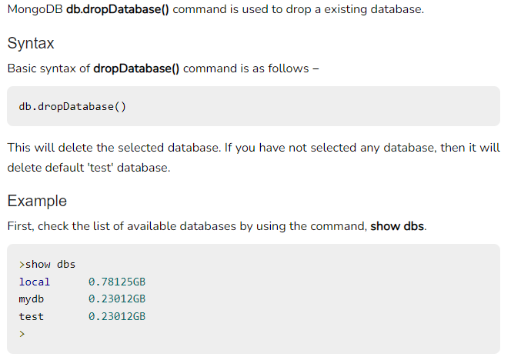
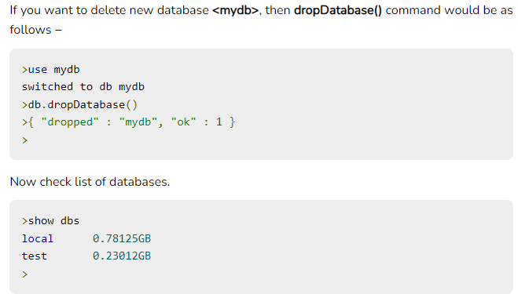
The dropDatabase() Method

Slide 14
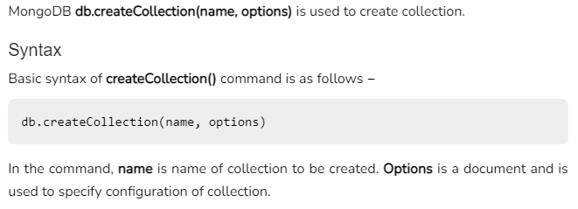
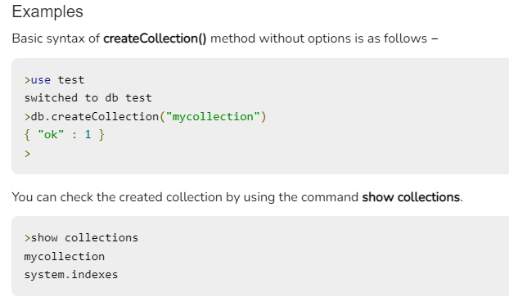
The createCollection() Method

Slide 15
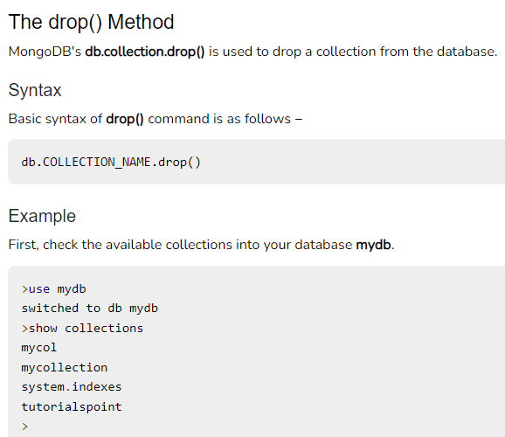
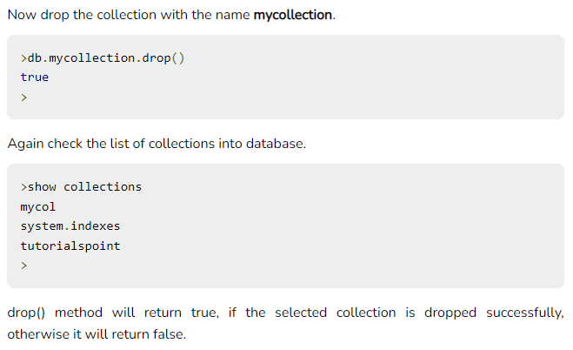
MongoDB - Drop Collection

Slide 16
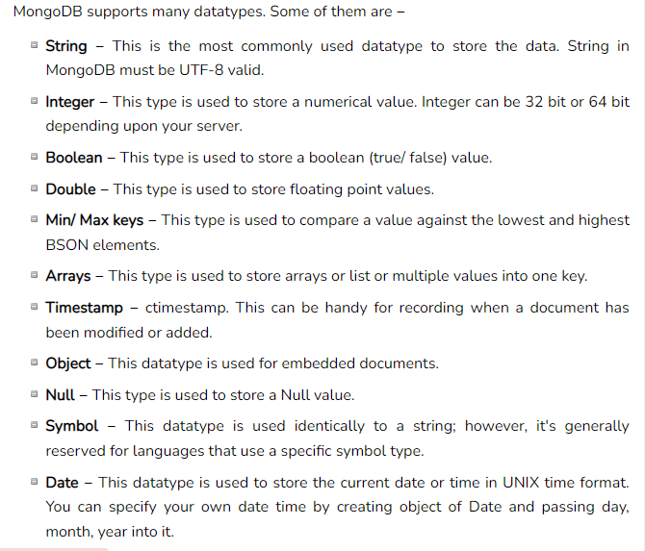
MongoDB - Datatypes

Slide 17
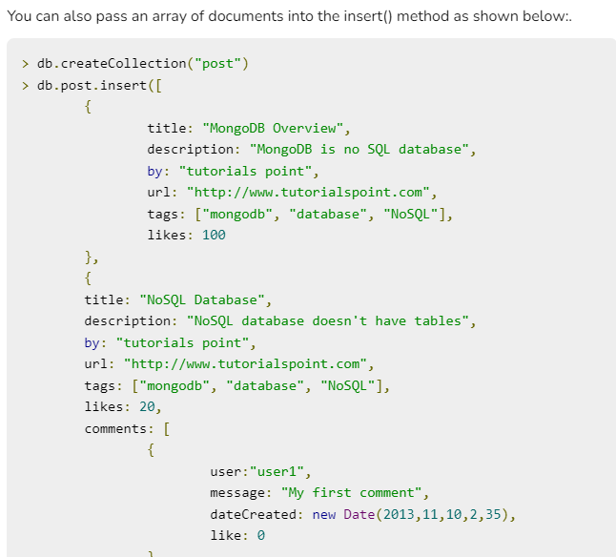
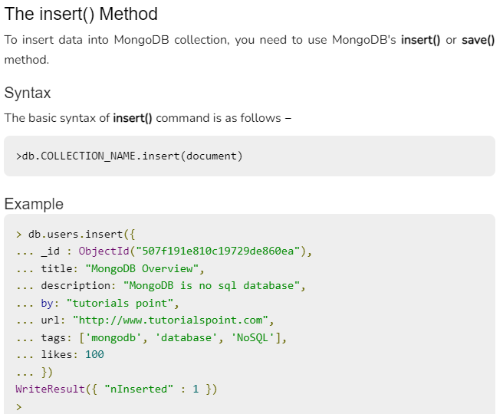
MongoDB - Insert Document

Slide 18
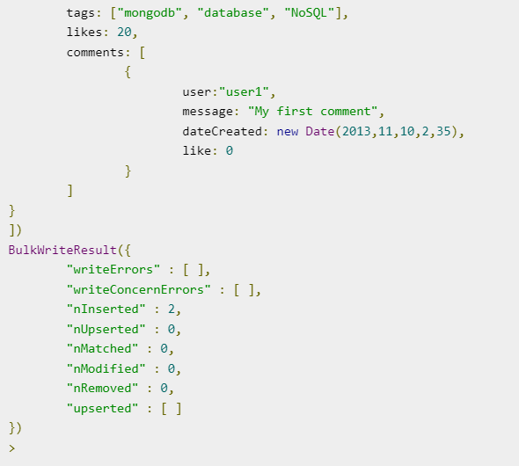
MongoDB - Insert Document

Slide 19
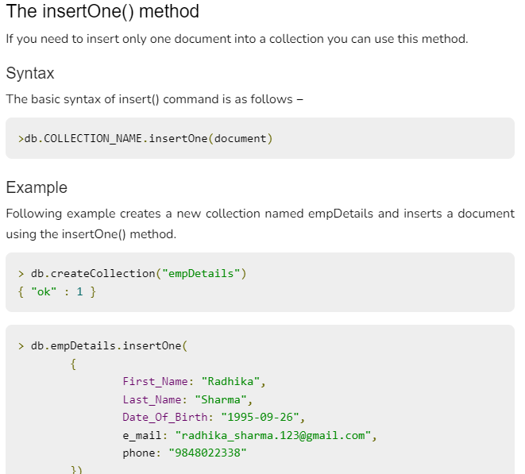
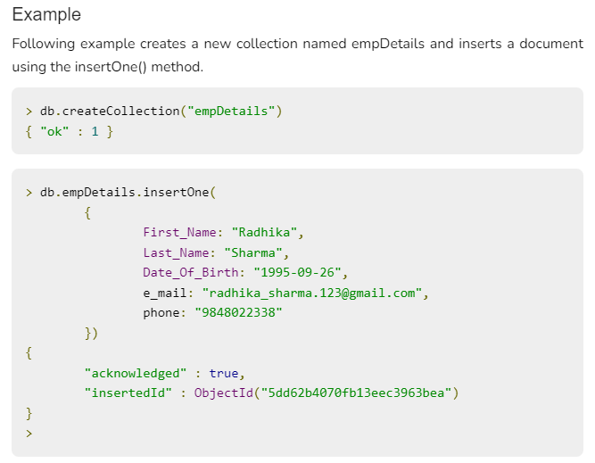

Slide 20
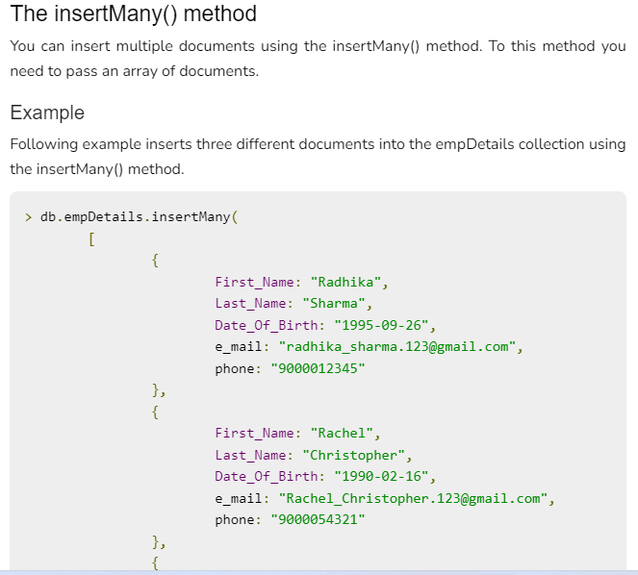
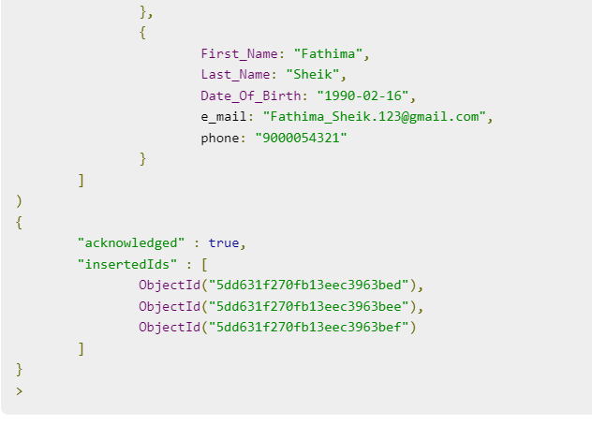

Slide 21
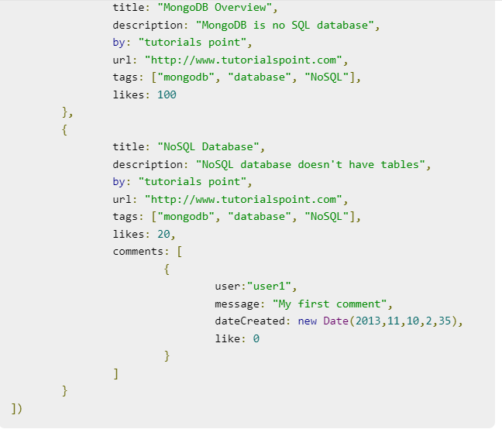
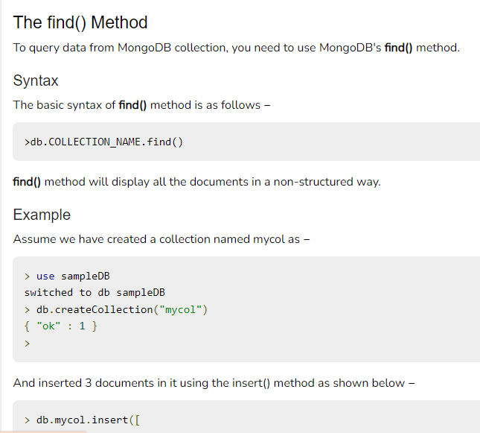
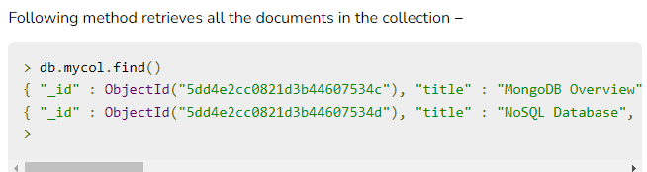
MongoDB - Query Document

Slide 22
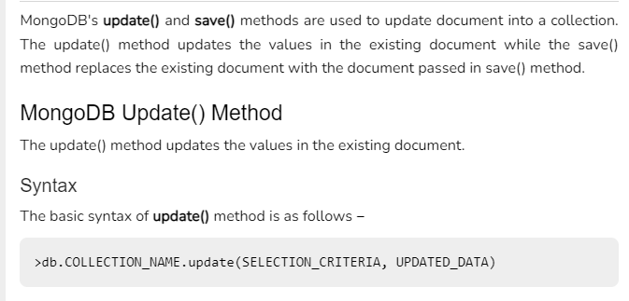
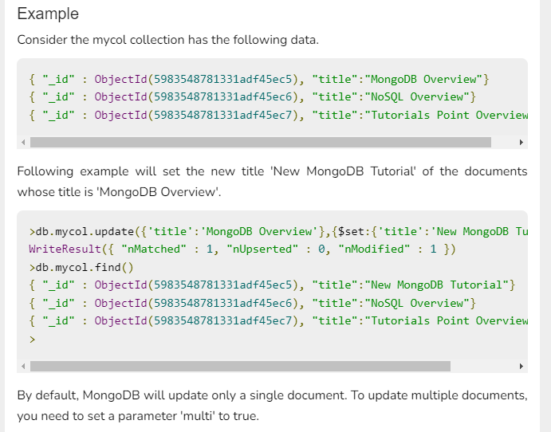
MongoDB - Update Document

Slide 23
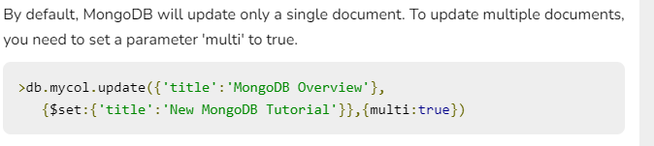
MongoDB - Update Document

Slide 24
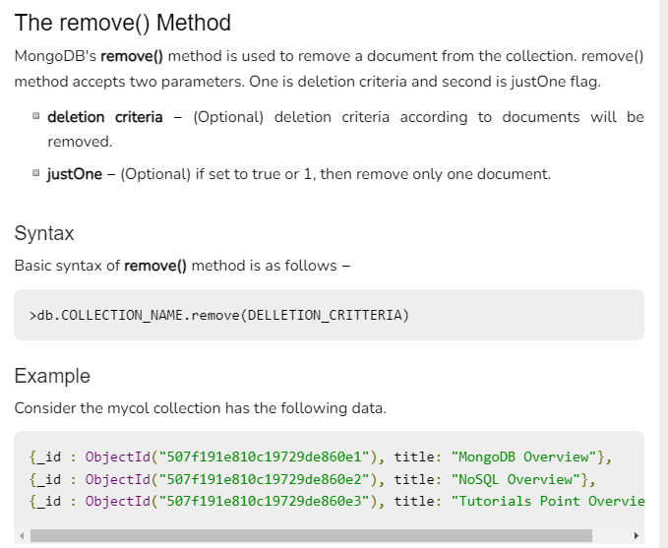
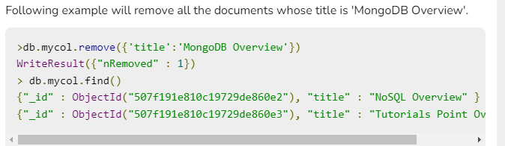
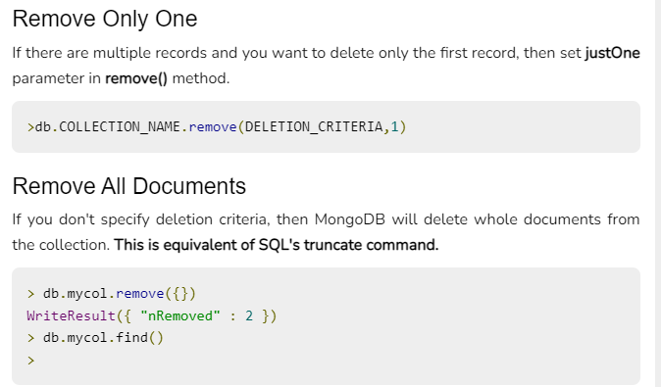
MongoDB - Delete Document

Slide 25
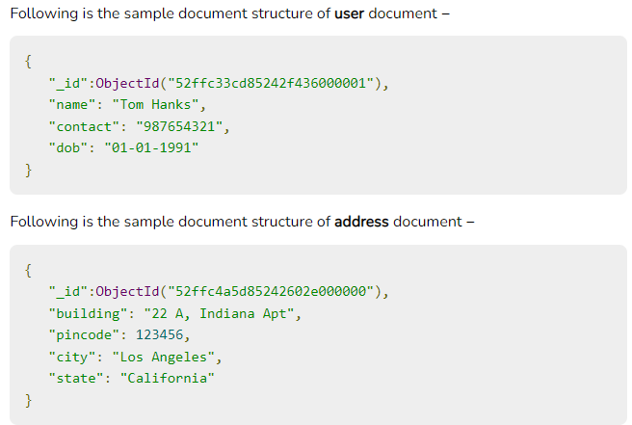
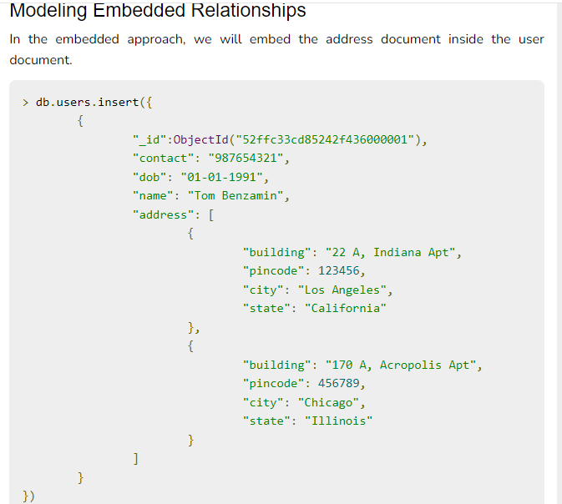
MongoDB - Relationships

